Slide 1
Welcome
RWI Book Bags
Parent workshop
10.2.20
Please tick the sheets alongside your child's name
Sue Hickman
Senior Assistant Head Teacher and phonics leader

Slide 2
Book Bag Books
These will be sent home in addition to their home reading books after half term.
These books are reinforcing the sounds and words that are being taught in phonics that week.
Some will be changed every 3 days and some every 5 days depending which phonics group they are in so please ensure that your child has these books in their bags daily and to bring them to their phonics session.
Your child will have been assessed recently and assigned to a phonics group. They do not move up a phonics group until I am sure they are saying the correct sounds.
Generally there are 3 activities –hearing your child read (day 1) retelling the story(day 2) and answering questions (day 3)
There are red and green words. Red words are the ones that they need to sight read and the green ones that they can use Fred Talk with.

Slide 3
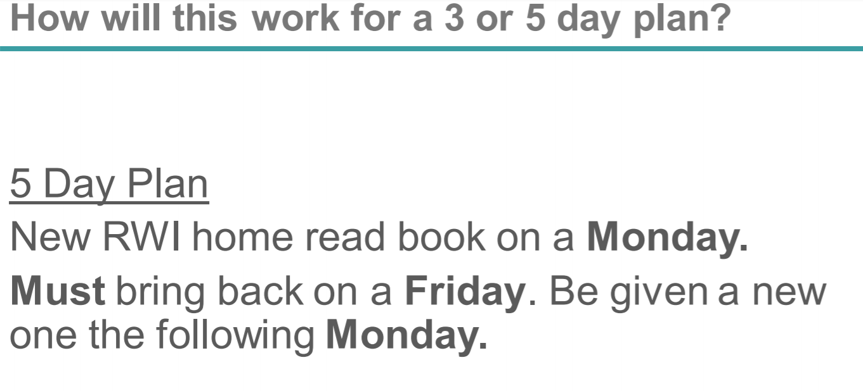

Slide 4
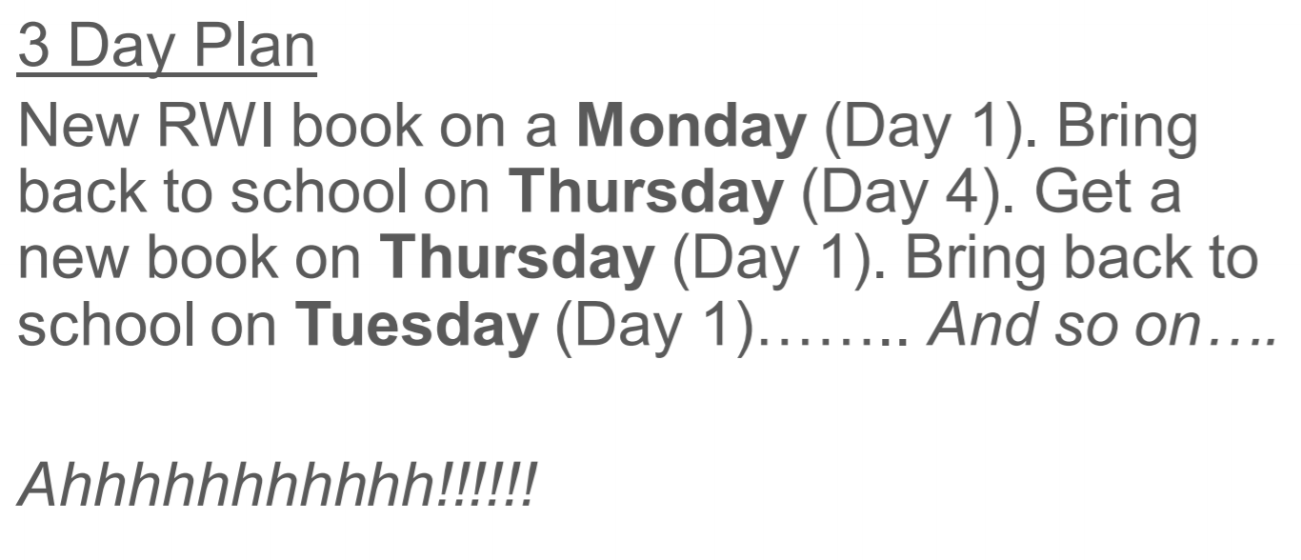

Slide 5
https://www.youtube.com/watch?v=VGsqPohuALo
We will not be sending the black and white books home as they already have a home reader that should be phonetically matched to their ability. However, we will be sending home the coloured book bag book .

Slide 6
How to say the sounds with your child
https://www.ruthmiskin.com/en/find-out-more/parents/#lg=1&slide=2
Saying the sounds the correct way is vital to support your child in segmenting and blending sounds together

Slide 7
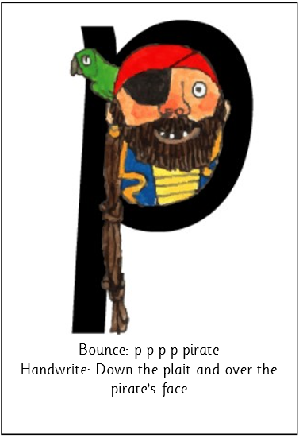
Flash cards
To help your child recognize and say the sounds correctly you can buy RWI flash cards from Amazon. There are 2 prices on there : the first is £4.66 for the at home ones and £9.50 for the ones that we use at school. Two sets will need to be purchased set 1 and set 2/3.

Slide 8
Speed Sounds Set 1
Notes:
Using RWI, we make learning to read easy for children because we start by teaching them just one way of reading and writing every sound. Here they are on the Simple Speed Sounds chart.
We teach Set 1 sounds first - (sounds as far as a e i o u).
Children need to know sounds – not letter names – to read words.
Use MTYT to teach each of the Set 1 sounds to parents.

Slide 9
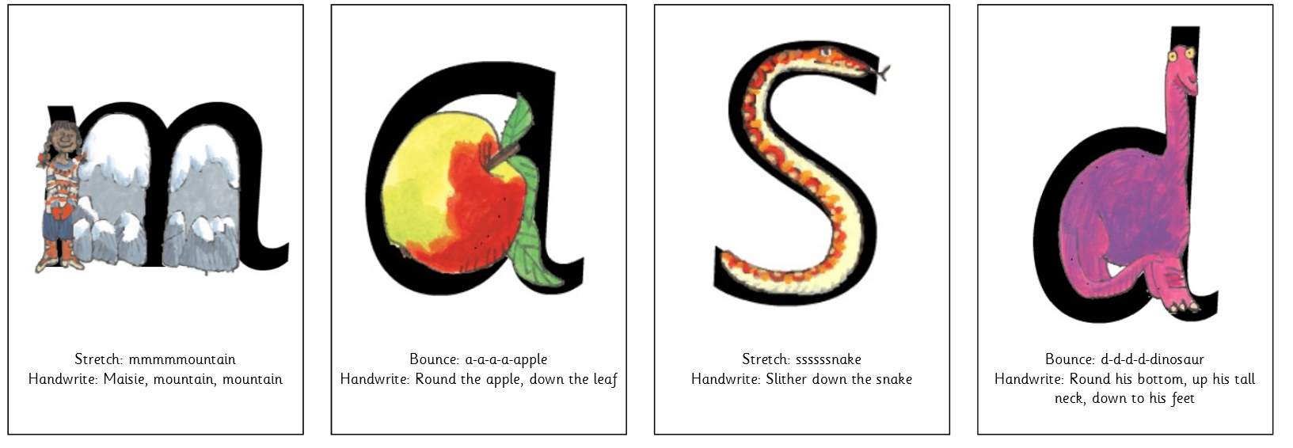





Slide 10
Speed Sounds Set 2
Notes:
Set 2 sounds are shaded. They are long vowel sounds with 2 or more letters. We call these ‘Special Friends’ – two letters together that make one sound.
Let’s practise saying these sounds together.
Say each sound MTYT.
Once children know these Set 2 sounds, they know one way of reading and writing every sound.

Slide 11
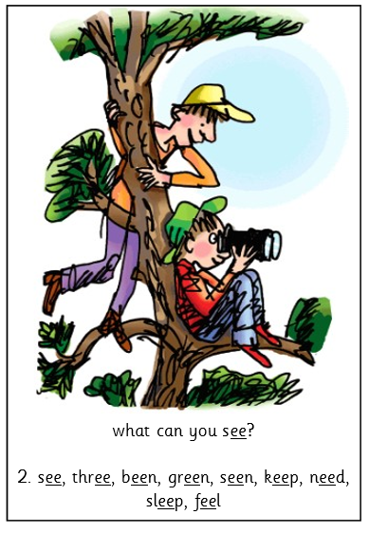


Slide 12
Speed Sounds Set 3
Notes:
Once children know how to read Set 2 sounds, they start to learn Set 3 sounds.
These are shaded in the chart.
They are alternative graphemes (spelling of a sound) for the Set 1 and Set 2 sounds the children already know.
Point to the chart to show. For example, they know ‘ay’ and now learn a-e and ai as other spellings for the same sound.

Slide 13
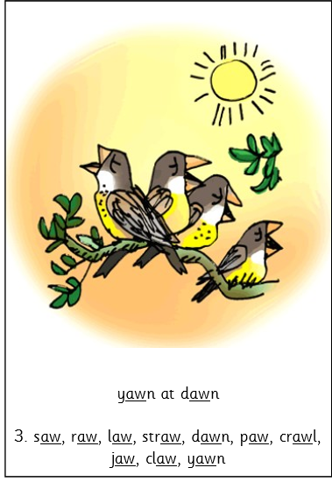


Slide 14
Thank you for attending
This power point will be put on the school website under Info for parents -> Help with phonics .

